Slide 1
Chapter 4: Von Neumann

Slide 2
Von Neumann

Slide 3
Von Neumann

Slide 4
Von Neumann Execution Cycle
CPU goes through four steps to process an instruction:
(1) fetch an instruction from memory
(2) decode the instruction and find out its opcode
(3) increment the program counter
(4) execute the instruction and store results

Slide 5
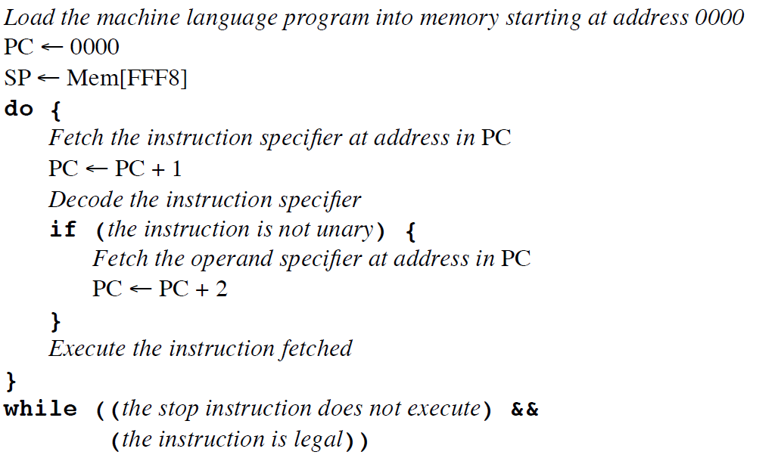
Von Neumann Execution Cycle
In pseudo-code, particular to our PEP/8 computer:

Slide 6
Von Neumann Execution Cycle

Slide 7
Von Neumann Execution Cycle

Slide 8
Von Neumann Execution Cycle

